Slide 1


CAPSTONE PROJECT - 2
YES BANK STOCK CLOSING PRICE PREDICTION
By – sanket kamble

Slide 2

CONTENTS
INTROCUTION
OBJECTIVE
PROBLEM STATEMENT
DATA UNDERSTANDING
EXPLORATORY DATA ANALYSIS (EDA)
MODEL IMPLEMENTATION
COMPARE ALL THE MODELS
CONCLUSION

Slide 3
INTRODUCTION
Yes Bank is a recognized bank in India's financial sector. Yes bank refers to Youth enterprise Scheme Bank. This bank listed in share market. The aim of this project is to construct a predictive model for close price prediction. The main point of the stock market is that people try to buy shares in a lower price and sell them when the price goes up, thereby making a profit. Any stock's price may vary depending on a number of variables. Events like the bank management personnel fraud case undoubtedly have a significant impact on stock prices.
Thus we are looking on such one case of Rana Kapoor yes bank fraud case. In order to forecast how other relevant features will affect the stock closing price of the bank, I have been given a dataset of Yes Bank stock prices. Several machine learning models have been applied to make a prediction.

Slide 4
OBJECTIVE
A dataset including information on Yes Bank's monthly stock price has been made available to us. This project's goal was to apply several models to see if it was possible to predict stock prices and movement using various characteristics and/or previous performance.
By analyzing the links between the dataset's various properties, we can train the model and finally forecast the closing price using the trained data by appropriately passing the necessary parameters.

Slide 5
PROBLEM STATEMENT
Yes Bank is a well-known bank in the Indian financial domain. Since 2018, it has been in the news because of the fraud case involving Rana Kapoor. Owing to this fact, it was interesting to see how that impacted the stock prices of the company and whether Time series models or any other predictive models can do justice to such situations. This dataset has monthly stock prices of the bank since its inception and includes closing,
starting, highest, and lowest stock prices of every month. The main objective is to predict the stock’s closing price of the month

Slide 6
DATA UNDERSTANDING
While looking to the Downloaded data sets we can see they provided one data_YesBank_StockPrices.CSV file. In this csv file. details of all stock prices are given . We have been given access to a dataset that has 185 rows and 5 total columns of variables, including "date," "high," "low," "open," and "close ".
Open: The price at which a stock began trading when the opening bell rang is referred to as the "open."
High: When we talk about high, we mean the maximum pricing at given time.
Low: Low pricing are minimum prices in a given time period.
Close:The closing price of a stock is its market value at the ending of a trading day.
Date: It indicates the date of the investment .

Slide 7

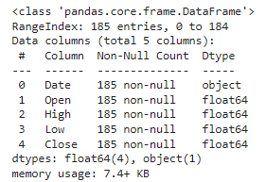
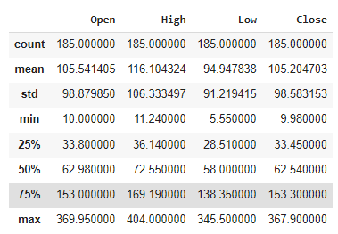
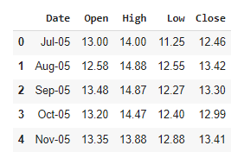
There is no null and duplicate value in our data set
Data is in string object type.
Data need to convert in date time object.
Summary of the data

Slide 8
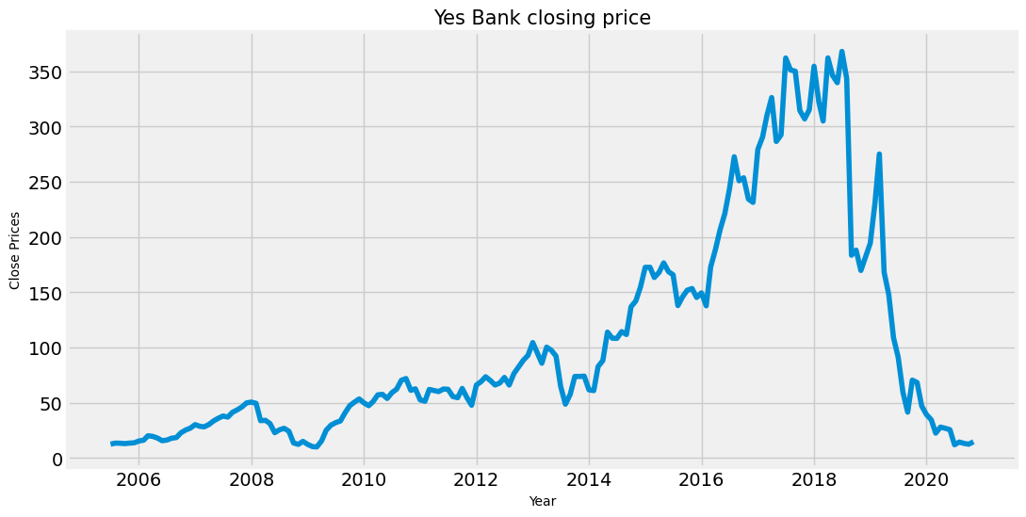
EXPLORATORY DATA ANALYSIS (EDA)
CLOSE PRICE VS DATE GRAPH PLOT
As the graph clearly shows, the stock price was up from 2014-18.
There is a sudden decrease in stocks after 2018 that justifies the effect of the fraud case against Rana Kapoor.

Slide 9
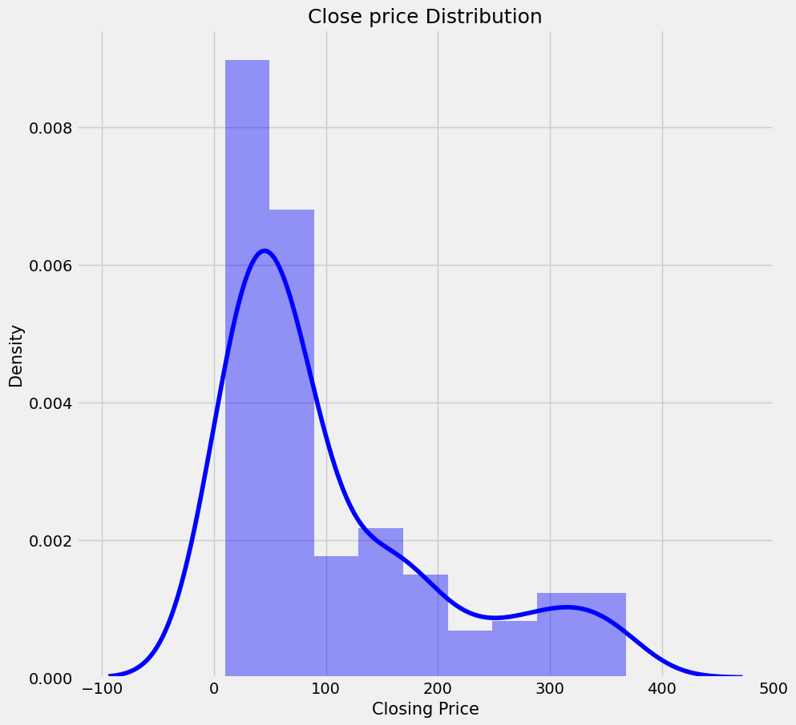
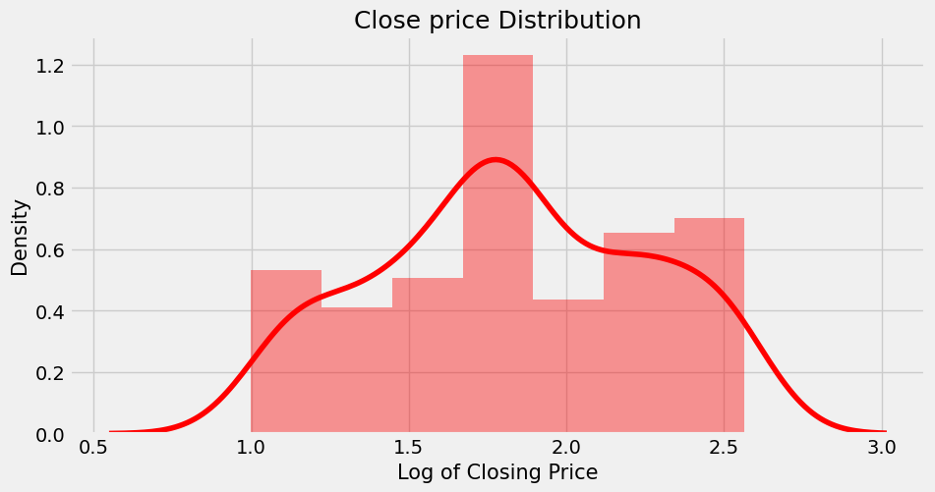
Data of closing price distribution plot is Right skewed
apply log transformation to make uniform distribution
distribution plot of Close price
After the log transformation, the closing price distribution is more normal
Applying log transformation to Close price distribution plot

Slide 10
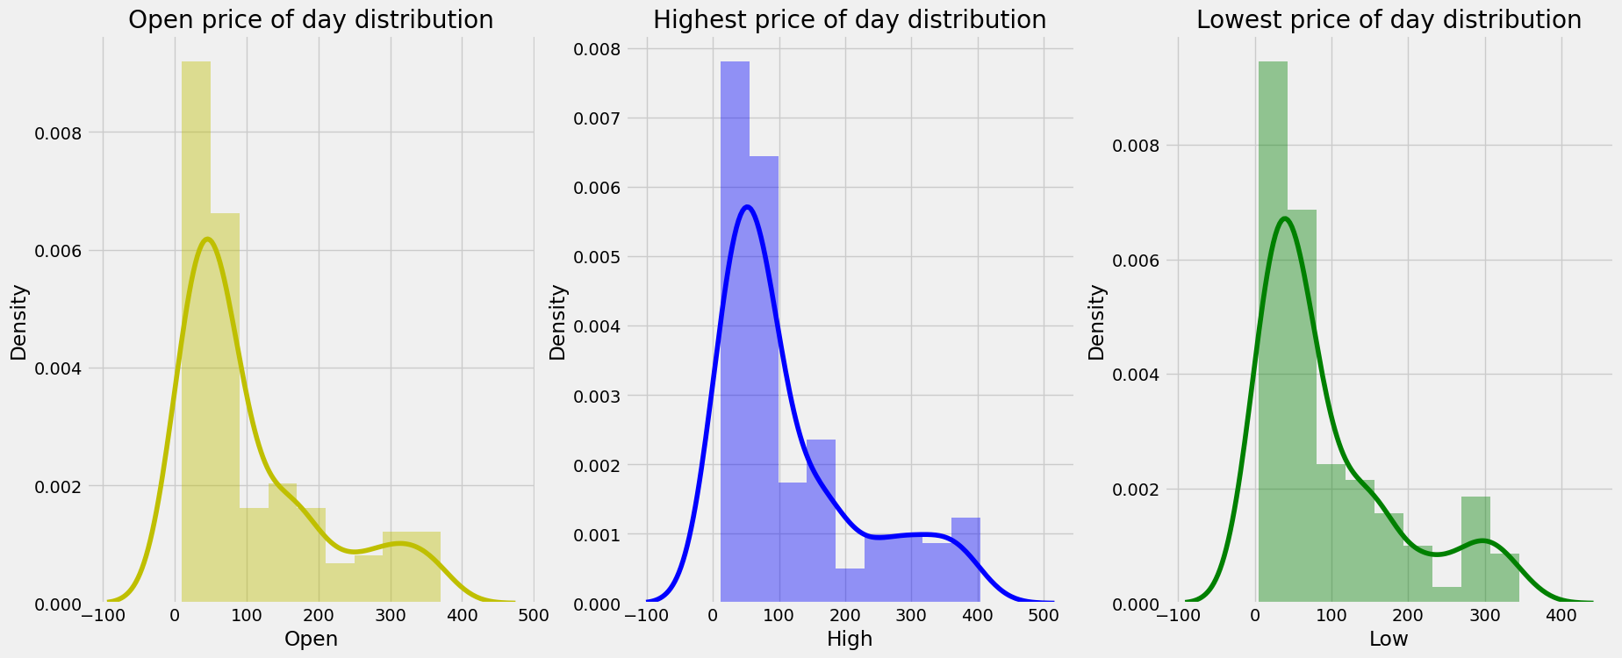
Opening price, high price, and low price distribution are all right skewed.
To make them normally distributed apply log transformation
Plot distribution for Open , High and low.

Slide 11
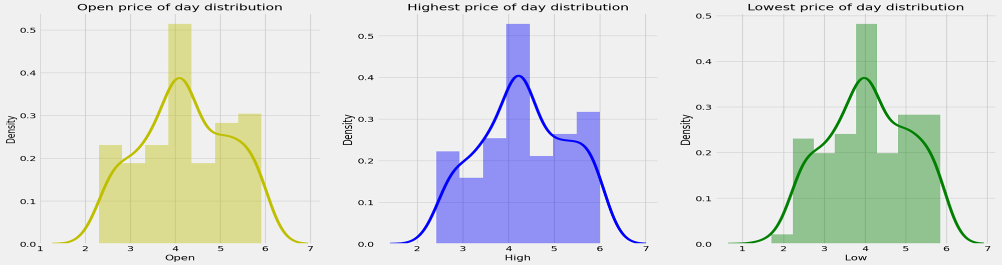
The observed data was discovered to be skewed, as seen in the slides that came before. Before provide the data to our machine learning models, we will change it to make it uniform.
PLOT DISTRIBUTION FOR OPEN ,HIGH AND LOW
The Opening Price, High Price and Low Price distribution is now a normal distribution.

Slide 12
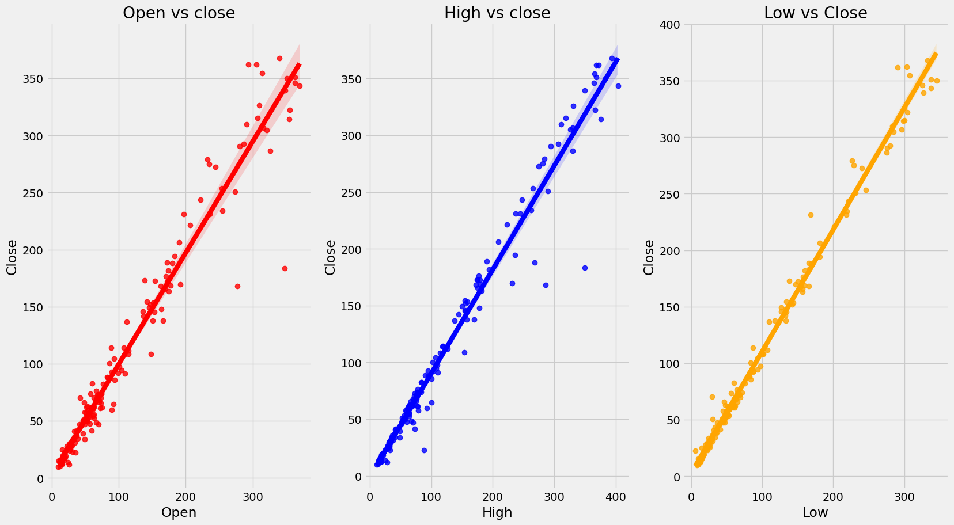
One of the most simple kinds of statistical analysis is bivariate analysis. Two variables are analyzed in order to figure out their empirical relationship with one another. Here we can see relationship between the Dependent Variable (close price) and Independent Variable
(open, High, Low price) .
In this entire scatter plot we can
conclude that bivariate analysis
shows high correlation of close
price with other features, and
other features also shows
correlation between each
Other.
scatter plot to see the relationship between target dependent (closing price) and independent variables

Slide 13
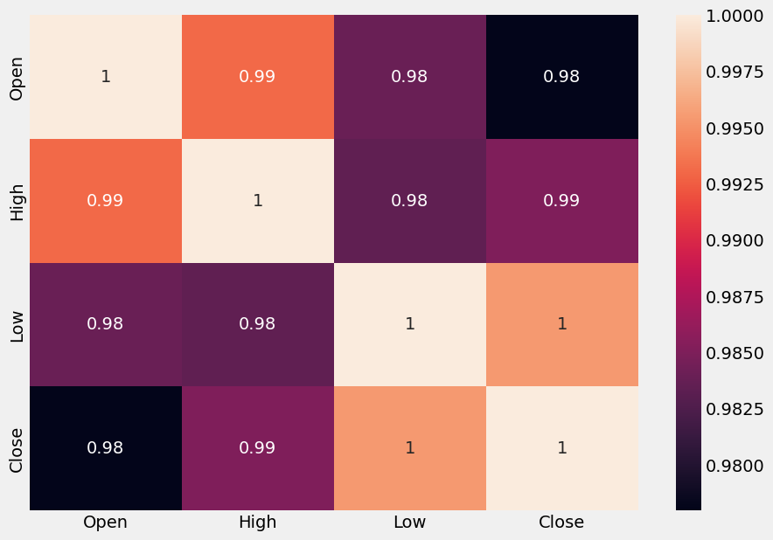
A procedure for determining the connections between two variables is known as correlation.
Positive correlation: There would be 1 correlation. This indicates that the two variables changed in the same direction, either up or down.
We have multicollinearity since there is a significant
correlation between the independent variables in
this situation. High multicollinearity makes it
difficult to fit models and make predictions since
even small changes to just one independent variable
can lead to wildly unanticipated outcomes.
Correlation analysis using Heatmap

Slide 14
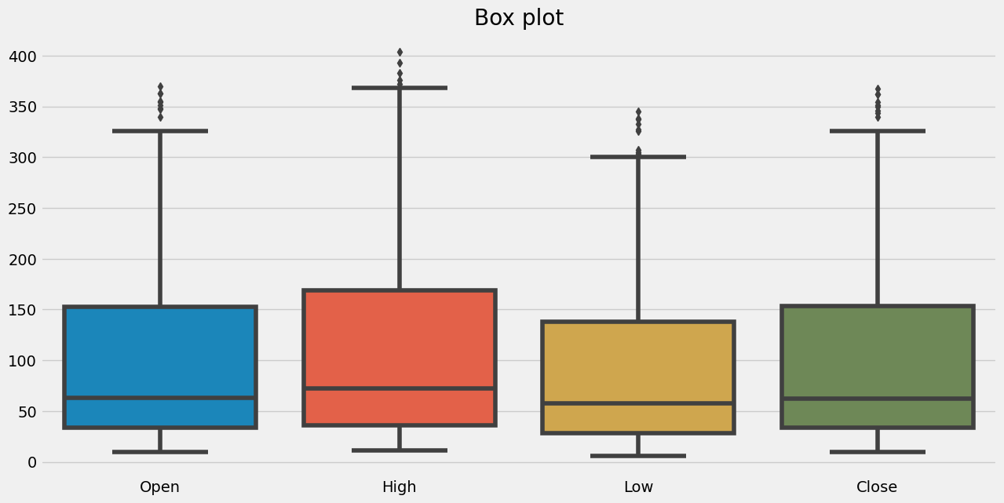
There are a few outliers. Every feature is extremely corelated with each other.
The median are close to each other.
Box plot

Slide 15
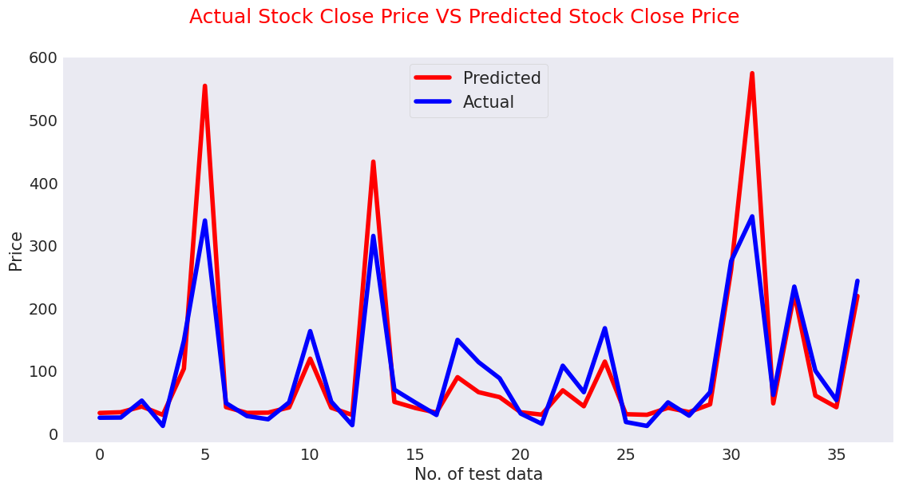
MODEL IMPLEMENTATION
1. Linear Regression
A variable's value can be predicted using linear regression analysis based on the value of another variable. The dependent variable is the one you're trying to predict. The differences between predicted and real output values are minimized by linear regression by fitting a straight line or surface.
Testing Performance of
Linear Regression Model
MSE : 0.032
RMSE : 0.178
MAE : 0.151
MAPE : 0.095
R2 : 0.823

Slide 16
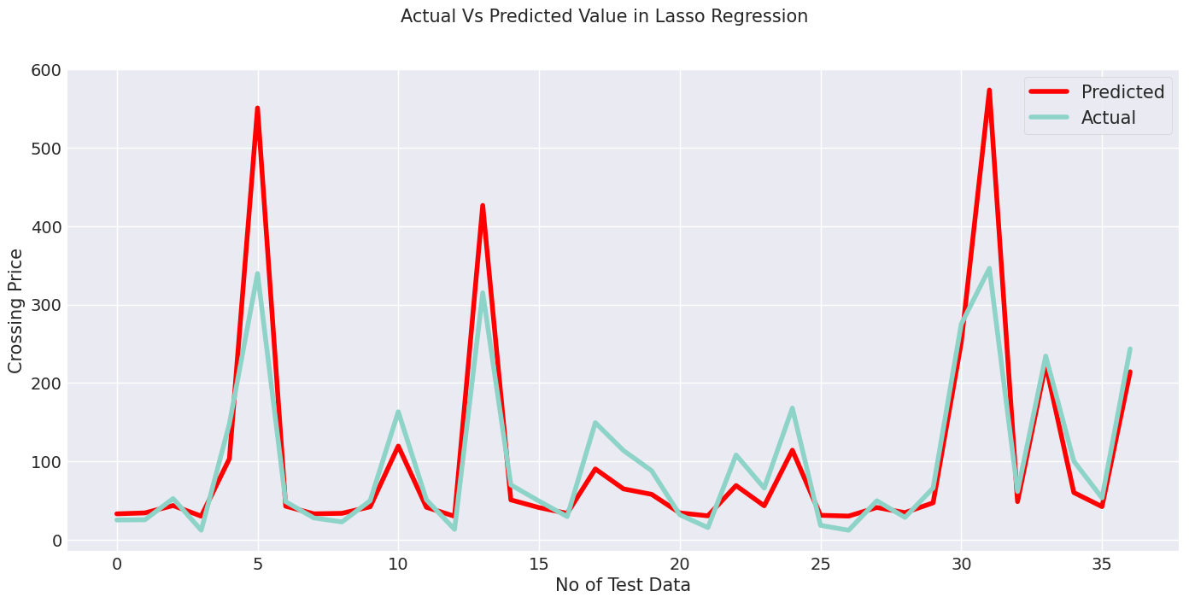
2.Lasso Regression
Lasso regression is a linear regression, but it uses a "shrinkage" technique where the coefficients of determination shrink to towards zero. Lasso (least absolute shrinkage and selection operator) is regression analysis method that variable selection and
regularization performs both in order to enhance the prediction accuracy and interpretability of the resulting statistical model. This method performs L1 regularization.
Evaluation Metrics of Lasso Regression
MSE score: 0.032
RMSE score: 0.179
MAE score: 0.152
MAPE score: 0.096
R2 score: 0.82

Slide 17
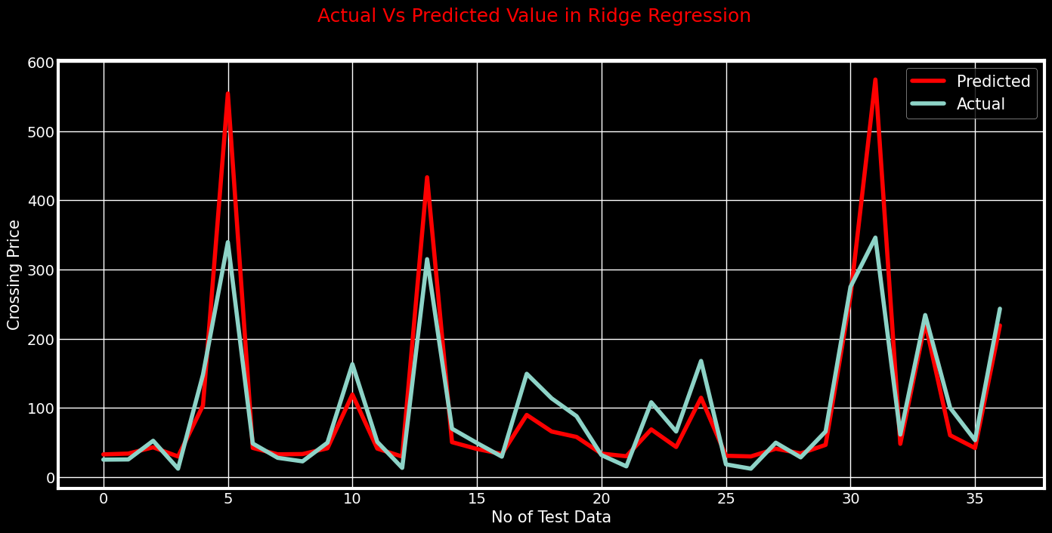
3.Ridge Regression
A regularized variation of linear least squares regression is ridge regression. It functions by reducing the weights or coefficients of the regression method. Ridge regression is a model adjustment method that is used to analyze any data that suffers from multi-llinearity. This method adjusts to L2. When the issue of multicollinearity occurs, least-squares are unbiased, and variances are large, this results in predicted values to be far away from the actual values.
Test Performance
MSE score: 0.0316
RMSE score: 0.1777
MAE score: 0.1513
MAPE score: 0.0954
R2 score: 0.8225

Slide 18
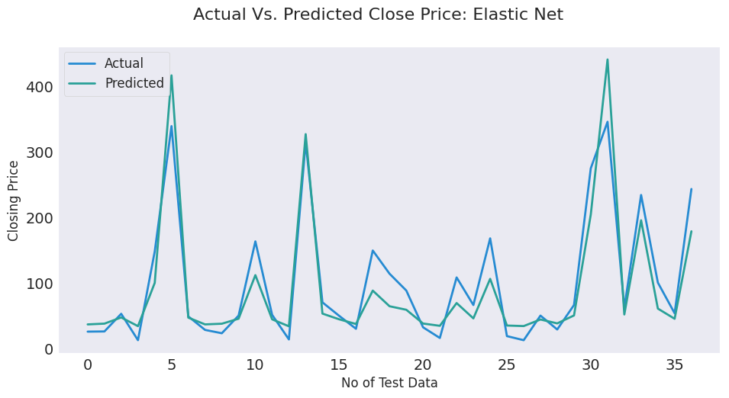
4.Elastic Net regression
The third type of regularization method is elastic net regression. It was created as a result of the Lasso regression's limitation. Lasso regression can’t take correct alpha and lambda values as per requirement of data. It combines two popular penalties, specifically the L1 and L2 penalty.
Test Performance
MSE : 0.036
RMSE : 0.191
MAE : 0.157
MAPE : 0.102
R2 : 0.796

Slide 19
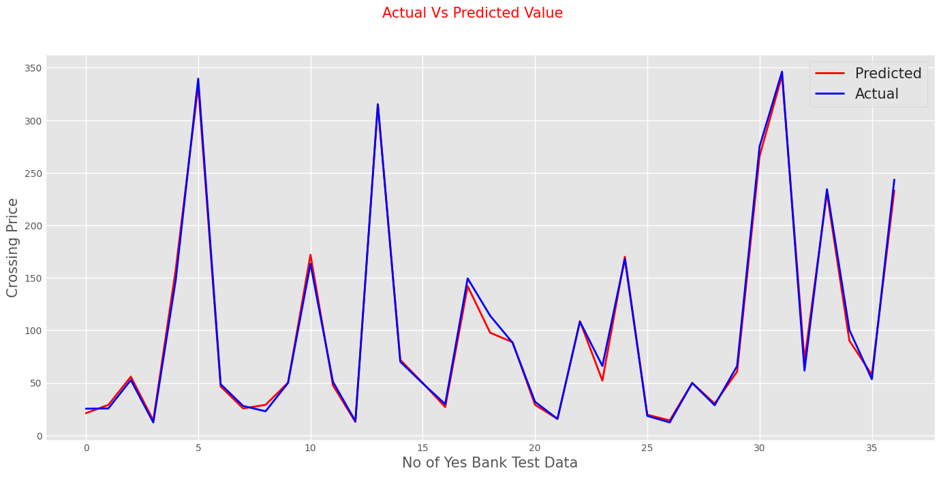
5.Gradient Boosting Regression
The difference between the present forecast and the known correct target value is calculated using gradient boosting regression. This variation is referred to as residual. After that, a weak model that maps features to that residual is trained using gradient boosting regression.
Test Performance
MSE : 0.002
RMSE : 0.041
MAE : 0.031
MAPE : 0.02
R2 : 0.99

Slide 20
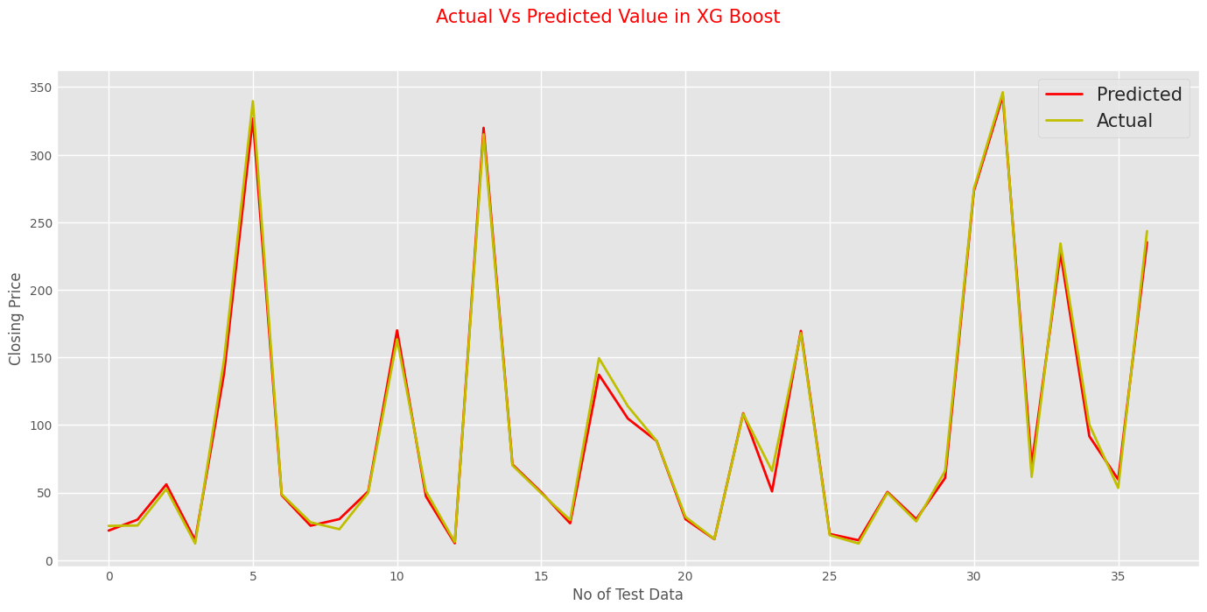
6.Extreme Gradient Boosting, or XGBoost regression
Each feature utilized for prediction is generally ranked in order of importance by the XGBoostRegression. Gradient boosting has the advantage that retrieving relevance ratings for each attribute is not too difficult after the boosted trees have been built.
The two key benefits of XGBoost are model performance and execution speed.
Test Performance
MSE score: 0.0019
RMSE score: 0.0433
MAE score: 0.0314
MAPE score: 0.0205
R2 score: 0.9894

Slide 21
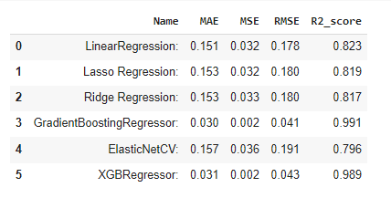
COMPARE ALL THE MODELS

Slide 22
CONCLUSION
Beginning from Exploratory Data Analysis we see the sudden change in stock price from 2014.
Bank share price is at the highest in 2018-19.After there is a Sudden fall in price of stock .
After that stock price start to increase again but price fall again.
From the scatter plot we can see High,open,low price of share are directly correlate with the closing price of share.
we applied following regression model on data set and result are evaluted and compared
1.LinearRegression 4.GradientBoostingRegressor
2.Lasso Regression 5. ElasticNetCV
3.Ridge Regression 6.XGBRegressor

Slide 23
we check test performance such as mean absoulte error, mean squared error, root mean squared error, r2
We got 99% highest accuracy for Gradient Boosting Regression and 98% for XGB Regressor
we got almost simillar result for Linear Regression, Lasso Regression and Ridge Regression
Cross Validation has been applied on various algorithms. However, the outcome is nearly identical.
Using data on the closing price of Yes Bank's shares, Gradient BoostingRegressor and Xgboost regression is the best model to apply.

Slide 24
THANK YOU
- Neil Armstrong

